Slide 1

Energy Efficient Wireless Communication
By: Esteban Martinez Mesa

Slide 2
What is EEWC
Energy efficiency is typically defined as “the number of bits that can be sent over a unit of power consumption”.
Quantified as bits per joule.
At a basic level, a wireless device consists of a radio unit and a baseband unit.
The radio unit receives and transmits messages (takes 57% of the power in wc)
The baseband unit transcribed the message that is to be sent or recieved.

Slide 3
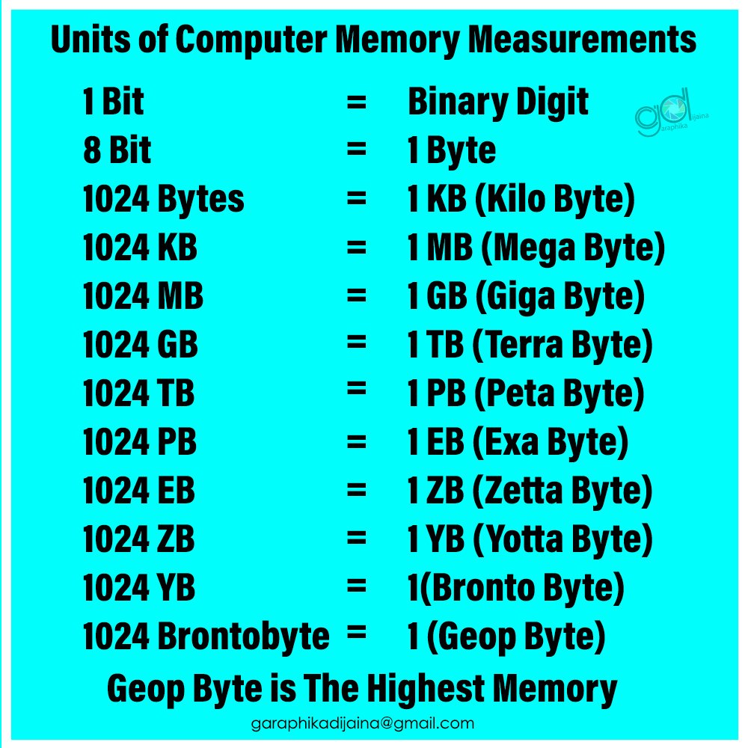
Why is it Important?
The number of Internet users increased from 413 million in 2000 to over 3.4 billion in 2016.
Due to the pandemic, The US saw an increase of 25% in internet activity.
These numbers will only continue to go up as technology becomes more widely accessible, furthermore our demand for transmitting larger quantities of data will also continue to go up.
Think about the demand that the metaverse will have over transmitting data

Slide 4
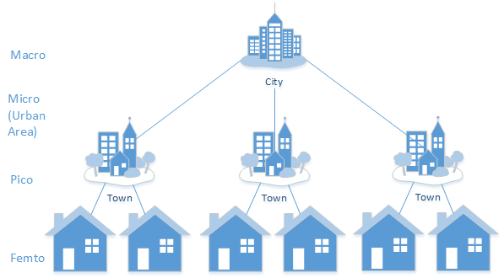
How is it Achieved
Heterogenous Networks
Greater number of nodes
Have the transmitter and receiver close together
Cells at the lower level have a smaller range and require less power

Slide 5

How is it Achieved II
Massive MIMO antennas
Large array of antennas.
Higher bandwidth and spatial diversity
Certain MIMOs can be adaptive
Can cause overlap
Adaptive Control
Optimally distributing network resources
Cognitive radios
Sleep modules

Slide 6
References
https://ourworldindata.org/internet
https://www.techrepublic.com/article/report-global-internet-traffic-patterns-have-risen-dramatically/
https://www.cse.wustl.edu/~jain/cse574-16/ftp/energyef/index.html#:~:text=Energy%20efficiency%20is%20usually%20defined,power%20needed%20to%20transmit%20data.

